Slide 1

Airline safety
-By DSC 640 Airlines

Slide 2

Road vs Airline safety

Slide 3
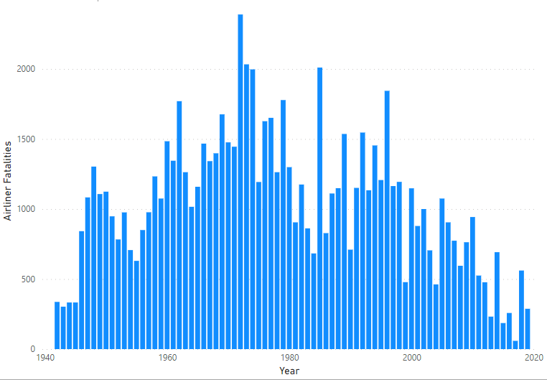
Airlines Fatality trend

Slide 4
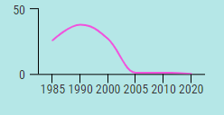
Flight hijacks

Slide 5
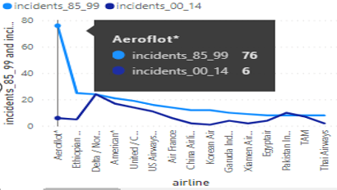
Airline incidents

Slide 6

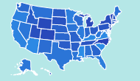
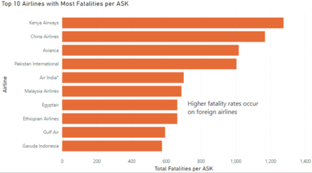
US Domestic flights-100% safe rate

Slide 7
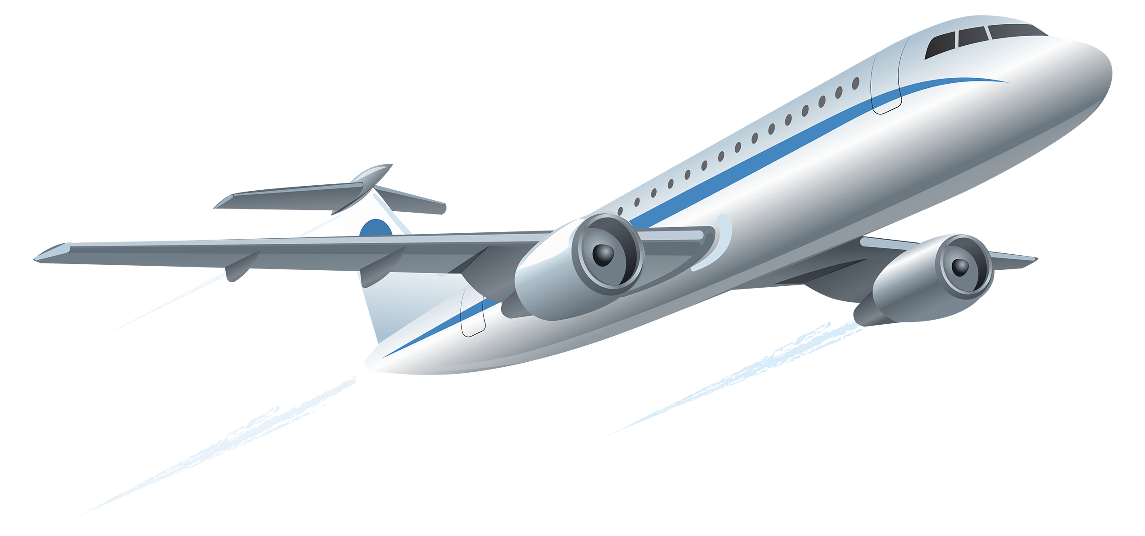
Conclusion

Slide 8


